Slide 1

RAD MICROBES
BOOT CAMP ON READING, ASSEMBLING, ANALYZING & DECHIPHERING MICROBIAL GENOMES
APRIL 28-29, 2025 | BRC AT RICE UNIVERSITY | HOUSTON, TX

Slide 2

Sampling, Sequencing, Quality Assessment and Control, and Assembly
Blake Hanson, MS, PhD
RAD Microbes Session 1
P01- AI152999-01

Slide 3
Sampling and Study Design

Slide 4
THE BIGGEST QUESTION
What is your goal?

Slide 5
Why is determining your goal important?
It guides the choice of sequencing technology
It helps in designing the experiment, including sample collection, preparation, and the depth of sequencing required
It ensures efficient use of resources and time, and aids in the interpretation and relevance of the findings

Slide 6
Generating a Reference Isolate for a Microbiology Experiment
Objective: To create a well-characterized reference isolate that can be used as a standard for comparison in microbiological studies
Methodology:
Isolate Selection: Choose a representative isolate from a known source
Whole Genome Sequencing (WGS): Perform WGS to obtain a complete genetic profile
Annotation: Annotate the genome to identify genes, operons, regulatory elements, etc.
Considerations:
Purity of Culture: Ensure the isolate is pure and not contaminated with other microorganisms
Reproducibility: The isolate should be easy to culture and maintain to ensure reproducibility in experiments
Level of completeness needed: Depending on the planned use of your reference, you may need to consider if short-reads, long-reads, or a combination of both are needed

Slide 7
Confirming a Mutation Following Genetic Modification
Objective: To confirm the presence and correctness of introduced mutations, as well as to assess for potential off-target mutations
Methodology:
PCR and Sanger Sequencing: For specific, targeted mutations. Does not provide insights for potential off-target mutations
Whole Genome Sequencing: For a comprehensive overview and to check for off-target effects
Considerations:
Target Verification: Verify that the mutation occurs at the intended site
Off-target Analysis: Screen for unintended mutations elsewhere in the genome

Slide 8
Pathogen Identification and Characterization
Objective: To identify unknown pathogens and characterize known ones, including studying antibiotic resistance mechanisms (AMR)
Methodology:
16S rRNA Sequencing: For bacterial identification
Whole genome sequencing: For bacterial identification as well as genetic content identification
AMR Gene Analysis: Using WGS to identify resistance genes
Virulence Gene Analysis: Using WGS to identify known virulence genes
Phylogenetics: Using WGS from multiple isolates to characterize a pathogen in terms of known isolates
Considerations:
Sample Source: Clinical, environmental, or other
Extraction and library preparation methodology
Data Analysis Plan: Bioinformatics tools for sequence alignment, phylogenetics, and resistance gene identification

Slide 9
Outbreak Investigation
Objective: To trace the source and transmission pathway of infectious disease outbreaks
Methodology:
Same methods as pathogen identification
Epidemiological Linking: Combining genomic data with epidemiological information
Phylogenetic Analysis: To understand the relationship between isolates
Considerations
Timeliness: Rapid sequencing and analysis are crucial in outbreak settings.
Spatial and Temporal Sampling: Important for tracking the spread and evolution of the pathogen

Slide 10
Epidemiology Surveillance
Objective: To monitor the population structure of pathogens and identify genomic factors associated with virulence or environmental adaptation
Methodology:
Same methods as pathogen identification
Pan-genome Analysis: To study the core and accessory genomes
Association Studies: Correlating genomic features with clinical/environmental factors
Considerations
Population Sampling: Representativeness of the samples to the population
Data Integration: Combining genomic data with clinical, environmental, and other relevant data

Slide 11
Sequencing

Slide 12
A brief history of sequencing
1986 – First commercial sequencer
1990 – BLAST algorithm developed
1996 – First eukaryotic genome sequenced (Saccharomyces cerevisiae)
1999 – First human chromosome sequenced (Chromosome 22)
http://www.sciencemag.org/posters/evolution-sequencing-technology
https://upload.wikimedia.org/wikipedia/commons/7/78/370A_automated_DNA_sequencer.jpg

Slide 13
A brief history of sequencing
2000 – First plant genome sequenced (Arabidopsis thaliana)
2001 – Drafts of human genome published
2007 – First complete sequence of single individual
2008 – 1,000 genomes project launched
2008 – Human Microbiome Project launched
http://www.sciencemag.org/posters/evolution-sequencing-technology
https://static1.squarespace.com/static/538e5c3ce4b02add9dca1fd5/
t/5412ef66e4b0508a6b9028fb/1410527133986/

Slide 14
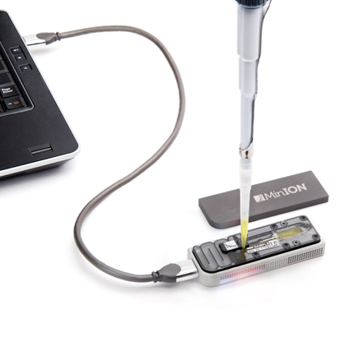
A brief history of sequencing
2009 – First 3rd generation sequencer available (Helicos sequencer)
2011 – Pacific Biosciences launches single molecule sequencer
2014 – Oxford Nanopore releases first nanopore based sequencer
http://www.sciencemag.org/posters/evolution-sequencing-technology

Slide 15
Illumina sequencing
Strengths
Extremely high base-calling accuracy (Q30+)
High throughput, low cost per base
Ideal for SNP discovery, small variant detection
Well-supported bioinformatics pipelines and standards
Suitable for high-throughput processing
Weaknesses
Short reads (150-300bp)
Complicates assembly of repetitive regions
Challenging for resolving large structural variants
Library prep can introduce biases (e.g. GC bias)
Assembly gaps common without long-read scaffolding

Slide 16
Oxford Nanopore sequencing
Strengths
Very long reads (often 10–100 kb; ultra-long >1 Mb possible)
Portable devices (MinION) enable field-based sequencing
Real-time data acquisition and analysis
Ideal for complete genome assembly (including plasmids)
Can detect base modifications (e.g., methylation)
Weaknesses
Higher raw error rates compared to Illumina (especially insertion/deletion errors)
Throughput lower than large Illumina platforms
Data quality can vary depending on flow cell and chemistry
Requires careful library prep for high molecular weight DNA

Slide 17
PacBio sequencing
Strengths
Long reads (15–30 kb on average; HiFi reads ~99.9% accuracy)
Excellent for high-quality microbial genome closure
Captures complex structural variants and repetitive regions
HiFi reads combine long-read length with Illumina-level accuracy
Suitable for both isolate genomes and metagenomes
Weaknesses
More expensive per Gb than Illumina
Requires specialized, larger instruments (e.g., Sequel IIe)
Lower throughput than short-read platforms for small projects
High molecular weight DNA required for best performance

Slide 18
Sequencing QA/QC, Assembly, and Assembly QA/QC

Slide 19
Why Quality Assessment is Critical
Accurate Genome Assembly and Annotation
High-Quality Reads: Accurate assembly of microbial genomes requires high-quality reads. Low-quality or erroneous reads can lead to misassemblies, gaps, and incorrect annotations
Annotation Accuracy: The quality of sequencing data directly impacts the accuracy of gene prediction and annotation. Errors in sequencing can lead to misidentification of genes, operons, and regulatory elements

Slide 20
Why Quality Assessment is Critical
Reliable Variant and Mutation Analysis
Detecting Variations: In microbial genomics, identifying mutations and variations is vital, especially for pathogen characterization, antibiotic resistance studies, and outbreak tracking
Error Distinction: High-quality data ensures that actual biological variations are distinguished from sequencing errors, which is crucial for reliable variant calling.

Slide 21
How do we control for low-quality data?
Pre-Processing Steps
Trimming: Removing low-quality ends of reads where errors are more frequent
Filtering: Discarding reads that do not meet quality thresholds
Quality Control Tools
Quality Metric Assessment: Utilizing tools like FastQC, MultiQC, or pycoQC for long-read technologies to assess various quality metrics (e.g., Q-scores, GC content, read length distribution)
Visualization: Employing visualization tools to inspect sequencing artifacts or anomalies
Post-Processing Validation
Assembly Validation: Using tools like QUAST or Bandage to validate genome assemblies
Read Mapping: Mapping reads back to reference genomes or assemblies to check for consistency and coverage

Slide 22
It is time, let’s look at some real data

Slide 23
Quick refresher – accessing our analysis space

Slide 24
Accessing NOTS
To access NOTS
ssh -tY USERNAME@radmicrobes.rice.edu ssh nots
Make sure you replace USERNAME with your provided ID

Slide 25
Entering an interactive session
This is important as the server we first log into is just a login node and cannot support all of us running analyses simultaneously
Run the following:
srun --partition=commons --pty --export=ALL --ntasks=1 --reservation=workshop --cpus-per-task=8 --mem=15GB --time=04:00:00 /bin/bash

Slide 26
Access the Session 1 software
Load the Mamba module (the software we are using for versioning and packaging)
module load Mamba/23.11.0-0
Activate the session 1 environment
conda activate /projects/k2i/session_conda_environments/radmicrobes-s1
Test to see if one of the software modules works
spades.py -h
Notes:
may need: conda init

Slide 27
Copy our data into your home directory
Make a session 1 folder in your home directory
mkdir session_1
Change your directory to the new session_1 folder
cd session_1
Copy the folder containing the Illumina reads and Oxford Nanopore reads into your session 1 directory
cp -r /projects/k2i/data/fastq_files/session_1/illumina/ ./
cp -r /projects/k2i/data/fastq_files/session_1/oxford_nanopore/ ./

Slide 28
Quality assessment of our fastq files – Illumina short read
Fastqc
Change your directory
cd illumina/
Make an output directory for fastqc to use
mkdir ARLG-4673_fastqc
Run fastqc
fastqc -o ARLG-4673_fastqc *fastq.gz
This will run fastqc on both R1 and R2 for the sample, and put the output into our defined output folder - ARLG-4673_fastqc

Slide 29
Quality assessment of our fastq files – Illumina short read
Fastqc
List the contents of the output folder
ls -l ARLG-4673_fastqc/
This lists the following files:
ARLG-4673_SRR12509049_1_fastqc.html
ARLG-4673_SRR12509049_1_fastqc.zip
ARLG-4673_SRR12509049_2_fastqc.html
ARLG-4673_SRR12509049_2_fastqc.zip
The HTML files are what we would usually look at if this were being run on our laptop or desktop computer, but for now we will be looking at the fastqc output within the zip file.

Slide 30
Trimming adapters and low-complexity regions
Change your directory back to the illumina folder
cd ../
Trimmomatic
trimmomatic PE ARLG-4673_SRR12509049_1.fastq.gz ARLG-4673_SRR12509049_2.fastq.gz ARLG-4673_R1_paired.fastq.gz ARLG-4673_R1_unpaired.fastq.gz ARLG-4673_R2_paired.fastq.gz ARLG-4673_R2_unpaired.fastq.gz ILLUMINACLIP:/projects/k2i/session_conda_environments/radmicrobes-s1/share/trimmomatic/adapters/NexteraPE-PE.fa:2:30:10:2:True LEADING:3 TRAILING:3 MINLEN:36

Slide 31
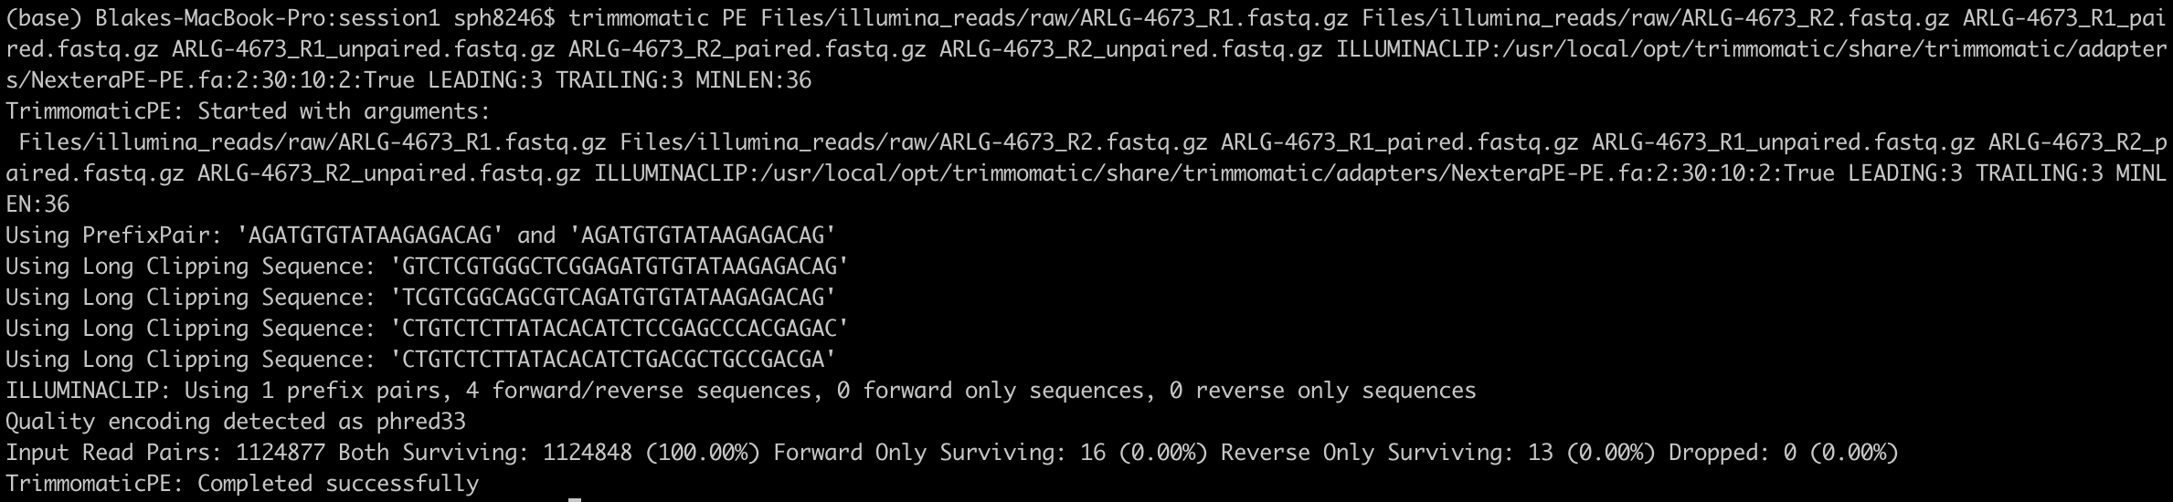
Trimmomatic output

Slide 32
Short read assembly
Spades.py
spades.py -t 8 --isolate --only-assembler -1 ARLG-4673_R1_paired.fastq.gz -2 ARLG-4673_R2_paired.fastq.gz -o ARLG-4673_spades_out
There are a LOT of ways to parameterize this assembler and a lot of options
The assembler is deterministic as well, meaning if you run it with the same parameters you will always get the same answer

Slide 33
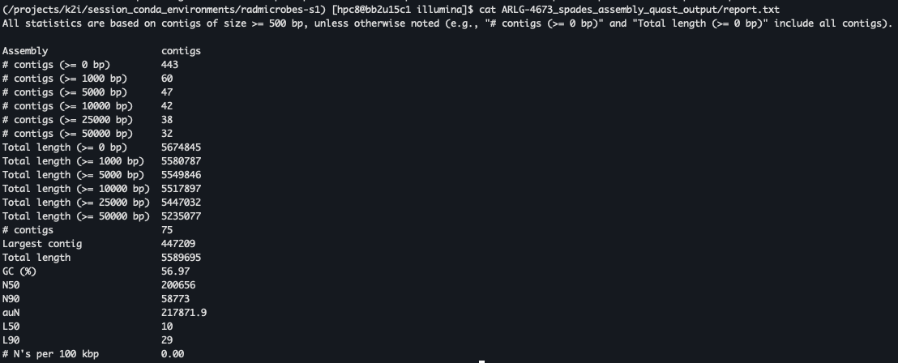
Quast assessment of Spades assembly
Quast
quast -t 8 -o ARLG-4673_spades_assembly_quast_output ARLG-4673_spades_out/contigs.fasta

Slide 34
Quality assessment of our fastq files – Oxford Nanopore long read
NanoPlot
Change your directory to the oxford nanopore directory
cd ../oxford_nanopore/
or
cd /home/YOURUSERNAME/reads/oxford_nanopore
Run NanoPlot
NanoPlot -t 8 --fastq ARLG-4673_SRR13289850.fastq.gz -o ARLG-4673_NanoPlot_output
There are a LOT of options to customize the output of this tool, we are keeping it simple

Slide 35
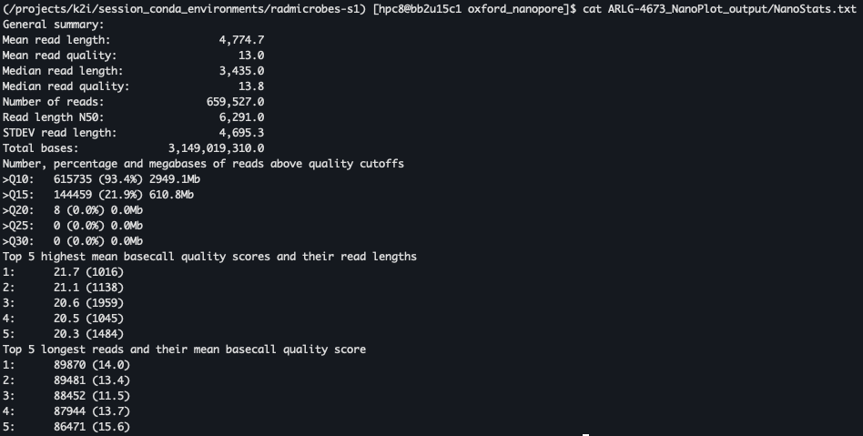
NanoPlot output
The HTML files are what we would usually look at if this were being run on our laptop or desktop computer, but for now we can look at the NanoStats.txt output

Slide 36
Randomly downsampling our data
We have roughly 572x coverage of this genome which is WAY overkill for our needs.
We will downsample our data to ~50x for our workshop efforts
rasusa reads --coverage 50 --genome-size 5.5m --output ARLG-4673_subsampled.fastq.gz ARLG-4673_SRR13289850.fastq.gz

Slide 37
Long read assembly
Flye
flye --nano-raw ARLG-4673_subsampled.fastq.gz --out-dir ARLG_4673_flye --threads 8
The parameters for Flye used here are correct for the generation of Oxford Nanopore data we are using today, but can be updated with more recently generated data
This assembly tool is not deterministic, so each of you will likely get a slightly different assembly

Slide 38
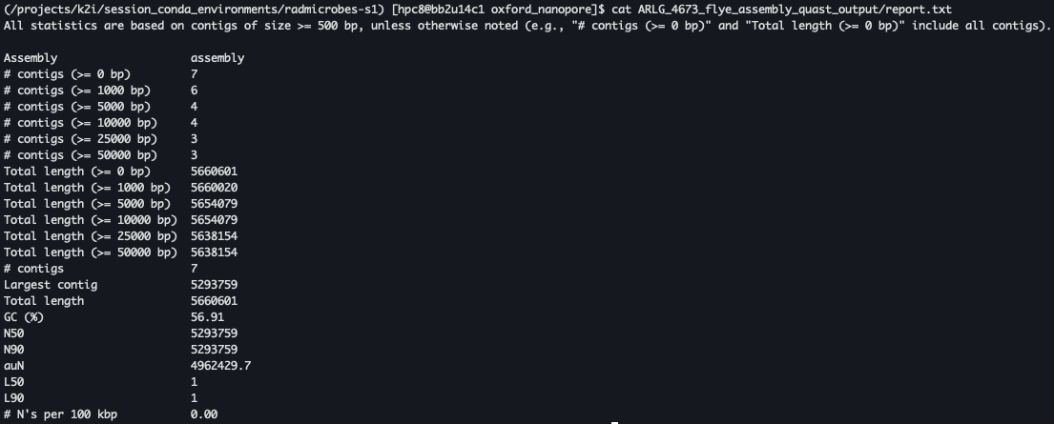
Quast assessment of Flye assembly
Quast
quast -t 8 -o ARLG_4673_flye_assembly_quast_output ARLG_4673_flye/assembly.fasta

Slide 41








Slide 42
Appendix

Slide 43
Introduction to the Unix Shell

Slide 44
Learning resources
There are many fantastic resources that can help you start your journey using Unix and bash/zsh or help you take your skills to the next level. A few are listed here:
Happy Belly Bioinformatics
Software Carpentry - The Unix Shell
Bioinformatics Workbook]

Slide 45
Learning resources
There are many fantastic resources that can help you start your journey using Unix and bash/zsh or help you take your skills to the next level. A few are listed here:
Happy Belly Bioinformatics
Software Carpentry - The Unix Shell
Bioinformatics Workbook]
We will be loosely following the Happy Belly Bioinformatics tutorial.

Slide 46
Spaces are not your friend
In Unix-based systems, spaces in file names can often lead to confusion and scripting errors, as the space character is a delimiter that separates command line arguments
To avoid these issues, it's recommended to use dashes (-) or underscores (_) instead of spaces in file names.
Instead of naming a file My Document.txt, name it My-Document.txt (using dashes) or My_Document.txt (using underscores)

Slide 47
Spaces are not your friend
Instead of naming a file My Document.txt, name it My-Document.txt (using dashes) or My_Document.txt (using underscores)
As you will see throughout this workshop, this should also be adopted for use with folder names so your file paths are easily navigable using terminal or PowerShell
Dealing with spaces in file names and folder names is the #1 error inducing issue I see when helping new scientists start out in this field.

Slide 48
Enough commands to make you dangerous

Slide 49
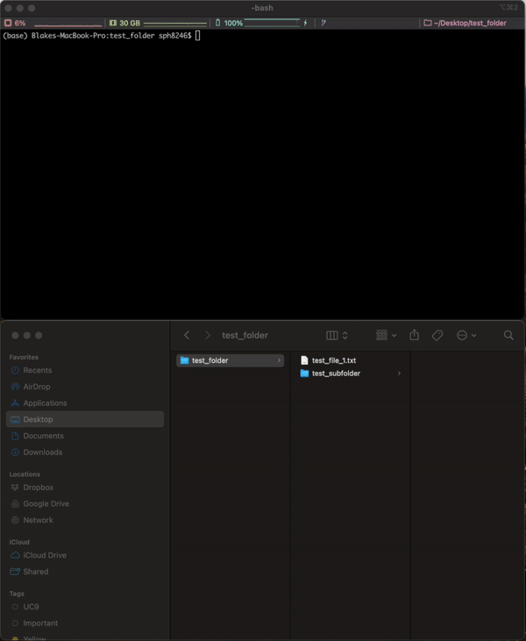
How do we navigate our file system using the command line?
This is an example onf my laptop
I want to find a file using terminal that I know is in a folder called test_folder.
To start with, I can confirm I am in the folder I think I am in using the pwd command
pwd (Print Working Directory)
Description: Shows the current directory path.

Slide 50
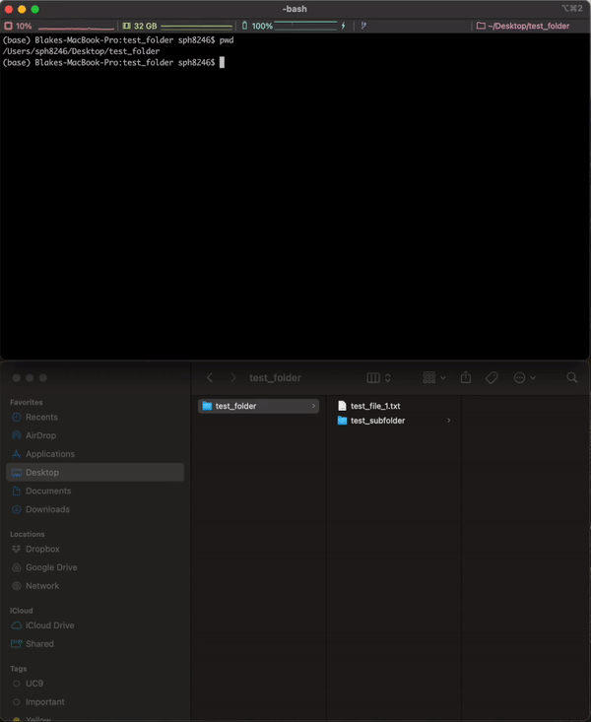
Navigation
Next, we want to look and see what is within test_folder. For this, we will use the ls command
ls (List)
Description: Lists files and directories in the current directory.

Slide 51
Navigation
ls
simply lists the names of the files and directories,
ls -s
provides information on the size in blocks of the files and directories listed
ls -l
but also provides information on the size of the files, indicates which are files (a dash as the first character in the column to the left) vs directories (the character d is the first character in the column to the left), as well as the read and write privileges for the objects listed.

Slide 52
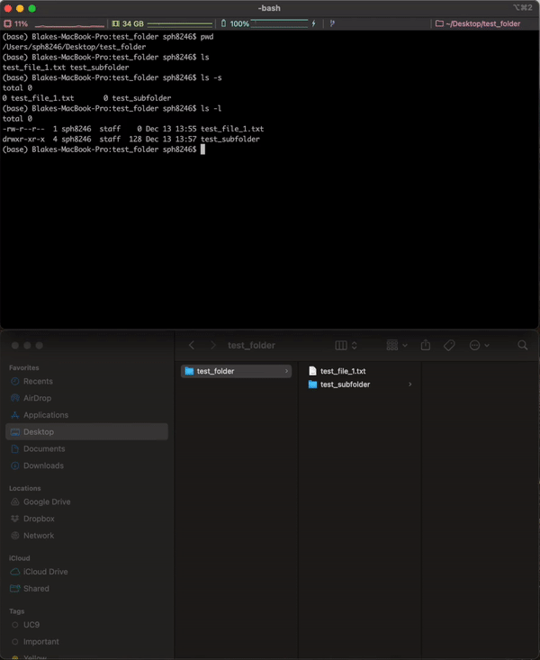
Navigation
We have another folder in our current directory.
I have not found the file I am looking for so I want to see what is within this test_subfolder
cd (Change Directory)
Description: Changes the current directory.

Slide 53
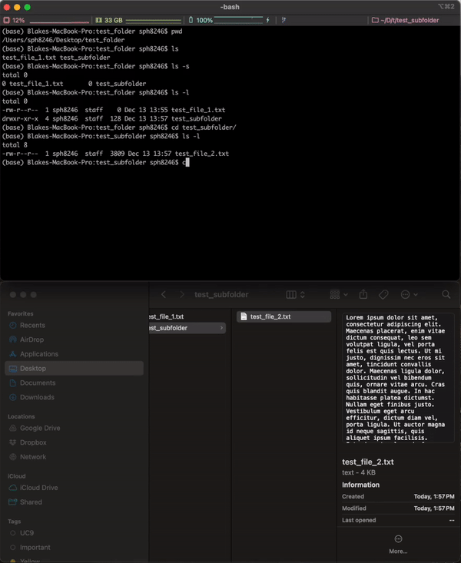
Navigation
I found another file! This may be the one I am looking for.
The ls –l command shows me this file is larger than the previous file I looked at. I want to see what is inside the file
cat (Concatenate)
Description: Displays file content, combines files

Slide 54
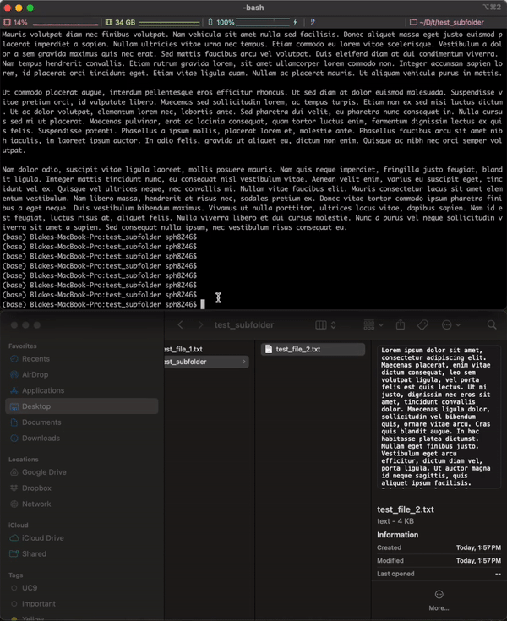
Navigation
This is the file I was looking for, let’s move it to where I originally expected to see it
mv (Move)
Description: Moves or renames files or directories.

Slide 55
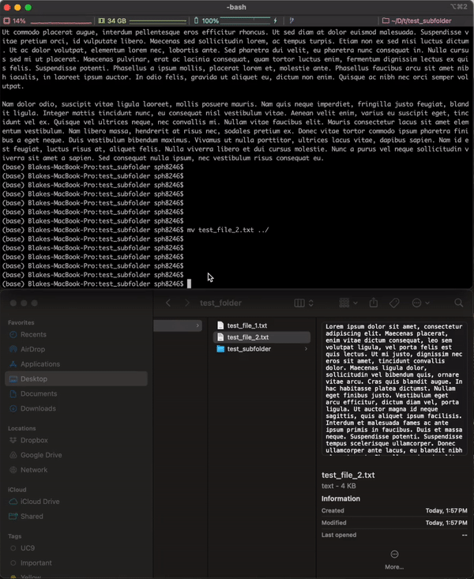
Navigation
Now that we have moved the file up a directory, let’s go to that directory
cd (Change Directory)
Description: Changes the current directory.

Slide 56
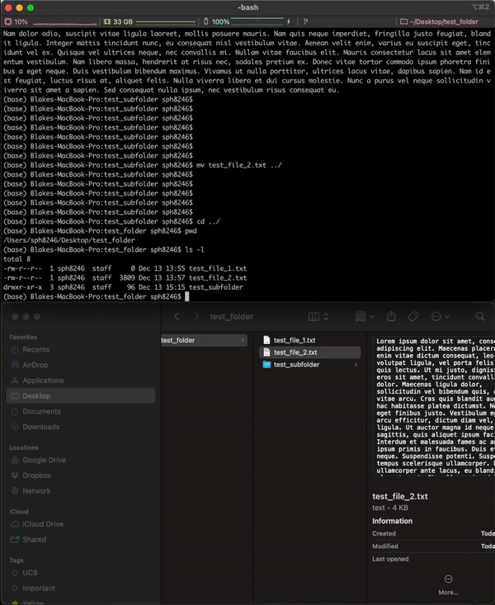
Navigation
Finally, let’s remove the original file we looked at so I don’t make the same mistake again
rm (Remove)
Description: Removes files or directories.

Slide 57
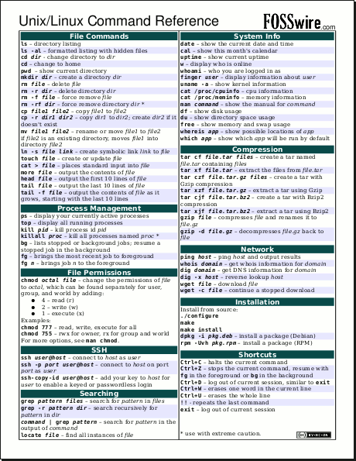
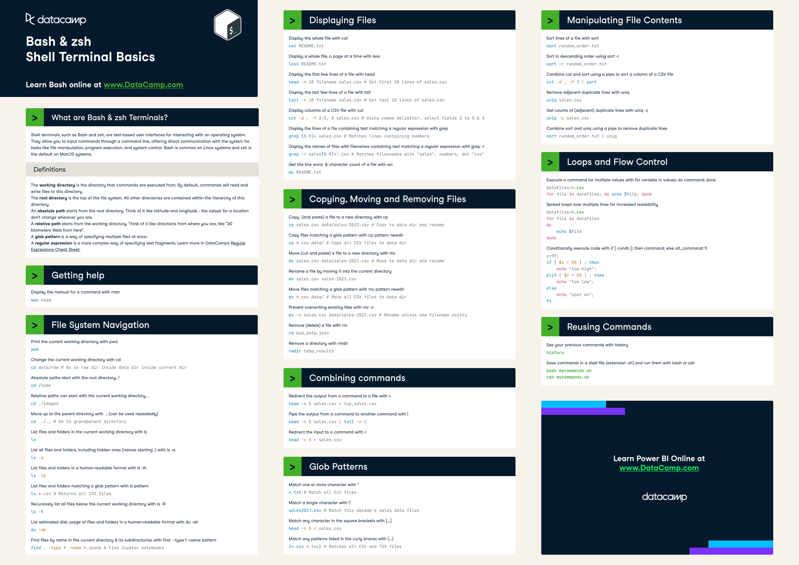
Cheat sheets are your friend

